Slide 1
Convolutional autoencoder for image denoising
Ralitsa Mihaylova
Nikhil Valse
Qifang Weng
Zubair Hossain Mahamud

Slide 2
What is the problem? Why is it interesting?
The objective of the model is to remove noise from images while preserving as much of the original image information as possible.
It is interesting because it achieves high levels of performance in image denoising as compared to traditional methods such as median filtering and wavelet transforms.
It is flexible, adaptable and can be applied to a wide variety of denoising tasks such as medical imaging, satellite imagery, surveillance, electronics and art restoration.
Also they are based on neural networks so they can learn more complex relationships and patterns in the data given to it for training. They can adapt to different types of noise and image characteristics making them more robust than predefined filters.

Slide 3
What are the real-world applications?
2. Real-world applications:
Medical image analysis, segmentation and classification
video compression: reduces the amount of space occupied by the file.
Autonomous driving EVs, object detection and lane detection.
Art Restoration: they can recover physically damaged historical pieces of art by removing noise and restoring missing details.
Satellite imagery: It can remove noise introduced by atmospheric interference, sensor noise and other factors and can improve accuracy of meteorological and environmental monitoring.

Slide 4
What are the challenges?
Autoencoder has 2 parts, encoder and decoder, encoder compresses input image to lower-dimensional and decoder reconstructs the original image from the compressed representation.
Main challenge is finding the right balance between removing noise and preserving important image features
The network built can possibly underfit or overfit since there were no techniques such as dropout or regularization implemented, however the task is just to denoise the images we can ignore it at least in our case.
Another challenge is selecting the appropriate hyperparameters for the model, such as the number of layers, the number of filters in each layer, and the size of the filters. Choosing appropriate hyperparameters can be a trial-and-error process, and may require significant computational resources.

Slide 5
What datasets are used?
The MNIST dataset was used from the Keras library. MNIST contains a collection of 70,000, 28 x 28 images of handwritten digits from 0 to 9.
There are sets of training and testing images and all images are grayscale images so only one channel is there.

Slide 6
Is data preprocessed?
Yes the data is preprocessed in the coding, using the predefined function “preprocess”, the arrays which contain pixel values were normalized divided by 255 to convert to values between 0 and 1. And then reshape the arries to 28 x28 x 1 ( 28 x 28 pixels) and 1 represents a grayscale image.

Slide 7
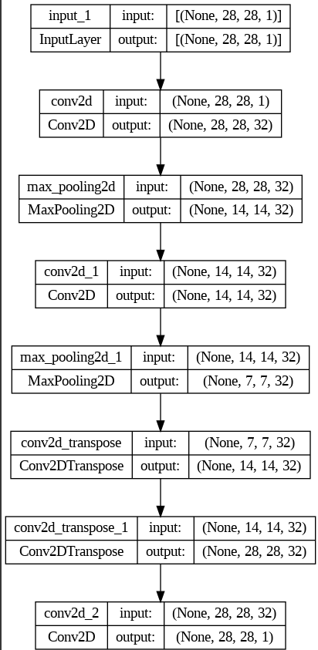
What is the architecture of the model/neural network?
The architecture consists of a symmetrically arranged encoder and decoder which means the number of filters in the encoding and decoding layers are the same.Input to this network is of shape 28x28x1 since the images are grayscale.
Encoder part is defined using two convolutional layers with 32 filters each and a kernel size of 3x3 and ‘same’ padding to maintain the size of the original image.
Each convolutional layer is followed by max-pooling layer with pool size 2x2 and again same padding to downsample the image

Slide 8
What is the architecture of the model/neural network?
Decoder part is defined using two transpose convolutional layers with 32 filters each and kernel size 3x3 and ‘same’ padding to upsample the image and restore its original size. They use a stride of 2 to increase the size of the output image by a factor of 2.
Decoder ends with a convolutional layer with one filter and kernel size of 3x3 and same padding. This layer produces a reconstructed image and is given a sigmoid activation function to ensure output values between 0 and 1.
Finally, the autoencoder model is given the "adam" optimizer and the "binary_crossentropy" loss function, which is commonly used for binary classification problems.

Slide 9
What methods and algorithms are applied in the code example? Can you suggest alternative methods and algorithms?
Preprocessing: which normalizes the pixel values between 0 and 1
Manual Noise: adding random noises to images to produce training and testing Inputs
Actual model: symmetrical arrangement of encoders and decoders described in previous slides is run first on the original data to check if it is working, and at the second time, we are training it on noisy data in which our target variable is original data.
In our model we are basically filtering the input noisy images with kernels and reducing their sizes to retain just the visual features of the digits and then we are again up sampling those images with extracted features with transpose convolutional layers to their original size.
And then we are predicting the outputs of the noisy test data to check visually if the model is removing the noise and maintaining original features.
Alternatively, we can use U-Net which is a type of convolutional neural network that is commonly used for image segmentation. It uses a contracting path and an expanding path to capture both local and global features of the image. In the context of image denoising.

Slide 10
How are the results evaluated? What are the evaluation results?
Results can mostly be evaluated visually by comparing the original images with denoised images.
However, various measures can be applied, such as the most commonly used MSE (Mean Squared Error), which is the average squared difference between reconstructed images and original images.
More sophisticated approaches such as Structural similarity index(SSIM) can be applied. It compares parameters such as contrast, texture and luminance. It outputs values between 0 and 1, 1 means perfect similarity.

Slide 11
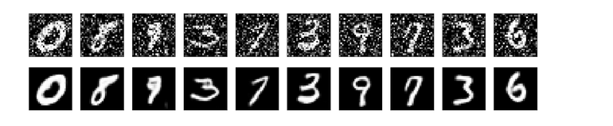
Are you satisfied with the model performance?
Yes we are satisfied with the model, for the MNist dataset, however, it might not perform well on new types of data such as digits in another language or writing styles, overall the model is giving very good results from the output, ultimately it will depend on the specific requirements and constraints of the problem at hand.

Slide 12
What can be done to improve the model/code?
One way to improve the performance of an autoencoder is to increase the model capacity by adding more layers or more neurons per layer. This can help the model learn more complex features and better distinguish between noise and signal in the input images.
Data augmentation: Data augmentation techniques can be used to generate additional training data by applying random transformations to the input images, such as rotations, flips, and zooms.
Ensemble learning: Ensemble learning involves combining the predictions of multiple models to improve the overall performance. In the context of image denoising, an ensemble of multiple autoencoder models with different architectures or trained on different subsets of the data can be used to improve the denoising performance.
The model may be improved with techniques, for example: regularization, choice of optimizer, hyperparameter tuning, and other autoencoder architectures like variations, denoising or sparse can be used to reconstruct the input images. Data augmentation to create new data by applying transformations to the existing data. And other methods to prevent model saturation or explosion.

